Slide 1
Fractional Encoding of At-Most-K Constraints on SAT
Nishimura Laboratory of Oita National College of Technology
Miki Yonekura
Notes:
Miki Yonekura from Nishimura Laboratory of Oita National College of Technology will give a presentation titled Fractional Encoding of At-Most-K Constraints on SAT

Slide 2
satisfiability problem
The problem of searching for variable assignments such that a given propositional formula is true
(x∨y)∧(￢x∨z)∧￢y
example : (x,y,z)=( true,false,true )
Satisfiable because there is an assignment that makes the logical expression true
Notes:
A satisfiability problem is a problem of finding a variable assignment such that a given propositional formula is true.
When there is such a logical expression, it can be said that the assignment exists and is satisfiable because the logical expression becomes true when x, y, and z are true, false, and true.

Slide 3
SAT Use Case
Various real-world problems can be converted to SAT and the solution can be searched by SAT solver.
In recent years, SAT solvers have achieved success in various fields with dramatic performance improvements.
Software model checking
Scheduling problem
Notes:
Various real-world problems can be converted to SAT and the solution can be searched by SAT solver.
In recent years, SAT solvers have achieved success in various fields with dramatic performance improvements.
Examples include software model checking and scheduling problems.

Slide 4
Solving Real-World Problems
Real problem
software model checking
scheduling problem
SAT
SAT encoding
Minisat
Glucose
principle
+ etc
At-Most-K Constraint
At-Least-K Constraint
+ etc
SAT solver
Solution
No abnormality
Feasible schedule
satisfiable
Unsatisfiable
Decode
Notes:
I will briefly explain the process
First, encode a real-world problem into the SAT. Encoding to the SAT means converting the real-world problem into a logical formula in SAT format.
and Solve it with the SAT solver. A SAT solver is a program that searches whether a SAT is satisfiable or not ,If it is satisfiable , it decodes the variable assignments and leads to the solution of the real problem.
In this research, we focus on SAT encoding , especially the At-Most-K constraint.

Slide 5

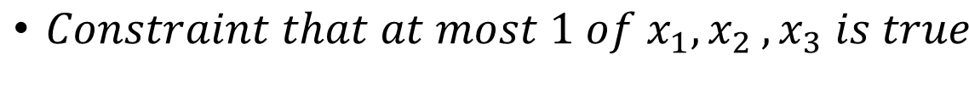
At-Most-K Constraint
Constraint that the number of variables that are true is at most K
( for expressing ≦ K in a logical expression )
Example : $X=\{x_{1}{,x}_{2},x_{3}\} K=1$ ( $At Most 1$ )
( Clauses : (a ∨ b) )
$Constraint that at most 1 of{ x}_{1}{,x}_{2},x_{3} is true$
Notes:
The At Most K constraint is a constraint that the number of variables that are True in any logical expression is at most k.
As an example, I present a simple At-Most-1 constraint with three input variables and at most one true variable.

Slide 6
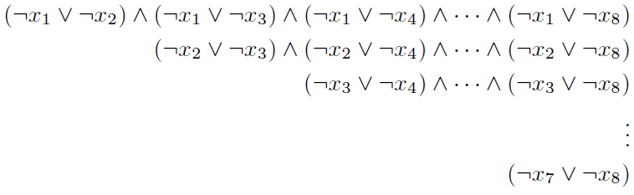
Pairwise Encoding
Simplest encoding method
Connect all combinations of variables with disjunctions and connect them with conjunctions
At-Most-1
Example : X = { x₁,x₂,x₃,x₄,x₅,x₆,x₇,x₈} K=1 )
Notes:
The previous formula was converted to SAT by the simplest encoding method called Pairwise Encoding.
Pairwise Encoding can express At-Most-1 constraints by connecting all combinations of variables with disjunctions and concatenating them.

Slide 7
Pairwise Encoding
As the number of input variables increases, the number of clauses (the scale of the formula) increases exponentially.
the SAT solver becomes large
At-Most-4/8 (4 of 8 variables true ) , the number of clauses ${{}_{8}^{}C}_{5}$→ 56
At-Most-4/16 , the number of clauses ${{}_{16}^{}C}_{5}$ → 4368
Reduce the number of clauses by splitting the input variables
I Proposed Fractional Encoding
Notes:
Pairwise Encoding has the property that the number of clauses increases exponentially as the number of input variables increases.
As a result, there is a problem that the computational complexity of the SAT solver increases.
For example, the At-Most-4of8 constraint, that is, the constraint that 4 of 8 variables are true, the number of clauses is 56 with the combination of 8 and 5, which is At-Most- four of sixteen. , it amplifies up to 4368.
Therefore, in this research, i propose an encoding method for SAT called Fractional Encoding, which reduces the number of clauses by dividing the input variables.

Slide 8



split variable
Consider splitting the input variables in At-Most-4/8 (K/ the number of input variables )
X={ x₁,x₂,x₃,x₄,x₅,x₆,x₇,x₈ }
≤ 4
AM4/8(X) : Up to 4 of the 8 variables are true
$g_{1}$ ={ x₁,x₂,x₃,x₄ }
$g_{2}$ ={x₅,x₆,x₇,x₈ }
≤ 2
≤ 2
AM2/4($g_{1}$) : Up to 2 of the 4 variables are true
AM2/4($g_{2}$) : Up to 2 of the 4 variables are true
Notes:
Using only Pairwise Encoding, it is possible to reduce the number of clauses by simply splitting the set of input variables in two.
When there is an At-Most-4/8 constraint, it can be split into an At-Most2/4 constraint and an At-Most-2/4 constraint in this way to express the same At-Most-4/8 constraint as before the split

Slide 9
split variable
At-Most-4/8 → At-Most-2/4 + At-Most-2/4
${{}_{8}^{}C}_{5}$→ ${{}_{4}^{}C}_{3}$ +${{}_{4}^{}C}_{3}$
$56 \text{clauses}$→ 8 ( 4 + 4 ) clauses
Reduce number of clauses by splitting input variables
problem
Input variables are simply split in two, solution space is reduced
Notes:
By splitting the input variables into two parts, the number of clauses can be reduced from 56 to 8.
Thus, by simply using Pairwise Encoding, the number of clauses can be suppressed even when the input variable is split in two.
However, if the input variables are simply divided into two parts, a problem arises: the solution space is reduced.

Slide 10












Fractional Encoding ( At-Most-4/8)
$$g_{1}$$
$$x_{1}$$
$$x_{2}$$
$$x_{3}$$
$$x_{4}$$
$$g_{2}$$
$$x_{5}$$
$$x_{6}$$
$$x_{7}$$
$$x_{8}$$
$${At Most 2/4(g}_{1})$$
$${At Most 2/4(g}_{2})$$
up to 2 true and up to 2 true
$${At Most 0/4(g}_{1}) and {At Most 4/4(g}_{2})$$
true up to 0 and true up to 4
$${At Most 4/4(g}_{1}) and {At Most 0/4(g}_{2})$$
true up to 4 and true up to 0
Introduce an auxiliary variable to control the split At-Most-K constraint
Notes:
The At-Most-4/8 constraint should be allowed to be true for any combination of up to four of the eight input variables in g1 and g2.
The previous two-part At-Most-4/8 constraint can only express a solution where up to two of the input variables in g1 are true and up to two of the input variables in g2 are true.
It is no longer possible to consider patterns where up to 0 of g1 is true and up to 4 of g2 is true.
To solve this problem of decreasing solution space, Fractional Encoding introduces an auxiliary variables to control the split At-Most-K constraints.

Slide 11














Fractional encoding ( proposed method )
$${At Most 2/4}_{}$$
propagation
$$g_{1}$$
$$g_{2}$$
$$x_{1}$$
$$x_{2}$$
$$x_{3}$$
$$x_{4}$$
$$x_{5}$$
$$x_{6}$$
$$x_{7}$$
$$x_{8}$$
$${At Most 4/8}_{}$$
$${At Most k/4(g}_{1})$$
$${At Most k/4(g}_{2})$$
Dynamically assigning At-Most-K constraints on split input variables by propagating proportions through auxiliary variables
Notes:
Fractional Encoding sets the base fraction for auxiliary variables added on top of the split At-Most-K constraints.
By propagating this to the lower layer through auxiliary variables, it is possible to dynamically assign At-Most-K constraints to the splitted input variables.

Slide 12




















Dynamic assignment of At-Most-K constraints
$${At Most 2/4}_{}$$
Set the fraction at the top layer
$$a_{1}$$
$$a_{2}$$
$$a_{3}$$
$$a_{4}$$
$AtMost2/4(a_{1}{,a}_{2},a_{3},a_{4})$
Set a ratio of 2/4
$${At Most 4/8}_{}$$
$$g_{1}$$
$$g_{2}$$
Add a constraint that allows up to twice as many variables to be true in the upper layer while maintaining the 2/4 ratio
$$x_{1}$$
$$x_{2}$$
$$x_{3}$$
$$x_{4}$$
$$x_{5}$$
$$x_{6}$$
$$x_{7}$$
$$x_{8}$$
$$0 of{ a}_{1},{ a}_{2 }is true$$
→ $・ AtMost0/4$: ($g_{1}$ )
1$of{ a}_{1},{ a}_{2} is true$
→ $・ AtMost2/4$: (${ g}_{1}$)
$$2 of{ a}_{1},{ a}_{2} are true$$
→ $・AtMost4/4$: ( $g_{1}$)
Notes:
I explain using the example of generating At-Most-4/8 constraints.
First, set an At-Most-2/4 constraint on the top layer auxiliary variables.
then , Add a constraint that allows up to twice as many variables to be true in the upper layer while maintaining the ratio of 2/4 .
For example, if 0 of the auxiliary variables a1 and a2 are true, then up to 0 of g1 are true
If one of a1 and a2 is true, then up to two of g1 are true
If 2 of a1 and a2 is true, then up to 4 of g1 are true
By adding such constraints, the At-Most-4/8 constraint can finally be expressed.

Slide 13









$$AtMost2/4$$
$$×2$$
$$AtMost4/8$$
$$×2$$
$$AtMost8/16$$
$${At Most 2/4}_{}$$
$${At Most 2/4}_{}$$
$${At Most 2/4}_{}$$
$${At Most 2/4}_{}$$
Notes:
Looking at the state of propagation, it looks like this.
The bottom layer is the split input variables. At-Most-K constraints for input variables in the bottom layer are dynamically determined by propagation.
In the previous example, the tree structure had only two layers , but it is also possible to generate At-Most-8/16 constraints by increasing the number of layers .

Slide 14









$$AtMost2/4$$
$$×2$$
$$AtMost4/8$$
$$×2$$
$$AtMost8/16$$
$${At Most 4/4}_{}$$
$${At Most 0/4}_{}$$
$${At Most 4/4}_{}$$
$${At Most 0/4}_{}$$
Notes:
We will also look at other propagation examples.
Because of the different propagation, the At-Most-K constraints on the input variables also change.
By dynamically determining the At-Most-K constraint in this way, the decrease in the solution space can be suppressed.

Slide 15
















problem
There remains a pattern of solutions that cannot be considered
( Solution space reduction occurs )
$$a_{1}$$
$$a_{2}$$
$$a_{3}$$
$$a_{4}$$
$${At Most 3/4}_{} and {At Most 1/4}_{}$$
$$g_{1}$$
$$g_{2}$$
$$x_{1}$$
$$x_{2}$$
$$x_{3}$$
$$x_{4}$$
$$x_{5}$$
$$x_{6}$$
$$x_{7}$$
$$x_{8}$$
$${At Most 1/4}_{} and {At Most 3/4}_{}$$
Notes:
So far , i have shown that dynamically assigning At-Most-K constraints to divided input variables can suppress the reduction of the solution space.
However , it turns out that there are still patterns that cannot be considered.
For example, it is not possible to express a case where up to 3 of the variables in g1 are true and up to 1 of the variables in g2 are true.

Slide 16
















Introduction of fine-tuning variables
solution
Increase or decrease the At-Most-K constraints of the split input variables by adding a new fine-tuning variable f
$$a_{1}$$
$$a_{2}$$
$$a_{3}$$
$$a_{4}$$
$$f_{2.1}$$
$$f_{2.2}$$
$$f_{1.1}$$
$$f_{1.2}$$
$$x_{1}$$
$$x_{2}$$
$$x_{3}$$
$$x_{4}$$
$$x_{5}$$
$$x_{6}$$
$$x_{7}$$
$$x_{8}$$
Notes:
Therefore , I add a new auxiliary variable called a fine tuning variable.
Fine-tuning variables can increase or decrease the At-Most-K constraints of the split input variables.

Slide 17





Introduction of fine-tuning variables
The fine-tuning variable determines the state for each set of splitted input variables
Increase or decrease the At-Most-K constraints of the splitted input variables depending on the state of each set
$$plus$$
$$minus$$
$$AtMost(k_{i}+1)$$
$$AtMost(k_{i+1}−1)$$
Notes:
The two fine-tuning variables define the state for the splitted set of input variables.
There are three states: plus, minus, and constant.
Depending on the state of each set, the At-Most-K constraints on the splitted input variables are increased or decreased in this way.

Slide 18
















Introduction of fine-tuning variables (At-Most-4/8 constraints )
$$a_{1}$$
$$a_{2}$$
$$a_{3}$$
$$a_{4}$$
$$g_{1}$$
$$g_{2}$$
$$x_{1}$$
$$x_{2}$$
$$x_{3}$$
$$x_{4}$$
$$x_{5}$$
$$x_{6}$$
$$x_{7}$$
$$x_{8}$$
$${At Most 2/4(g}_{1})$$
$${At Most 2/4(g}_{2})$$
Notes:
the At-Most-4/8 constraint as an example to see how it works.
In this way , divides the input variable into two .

Slide 19






Introduction of fine-tuning variables
$$a_{1}$$
$$a_{2}$$
$$a_{3}$$
$$a_{4}$$
$$f_{2.1}$$
$$f_{2.2}$$
$$f_{1.1}$$
$$f_{1.2}$$
$$g_{1} :plus$$
$$g_{2}:minus$$
$$x_{1}$$
$$x_{2}$$
$$x_{3}$$
$$x_{4}$$
$$x_{5}$$
$$x_{6}$$
$$x_{7}$$
$$x_{8}$$
$${At Most 2/4(g}_{1})$$
$${At Most 2/4(g}_{2})$$
Notes:
For each set, define a state with fine tuning variables.
In this example g1 is plus and g2 is minus .

Slide 20


Introduction of fine-tuning variables
$$a_{1}$$
$$a_{2}$$
$$a_{3}$$
$$a_{4}$$
$$f_{2.1}$$
$$f_{2.2}$$
$$f_{1.1}$$
$$f_{1.2}$$
$$g_{1} :plus$$
$$g_{2}:minus$$
$$x_{1}$$
$$x_{2}$$
$$x_{3}$$
$$x_{4}$$
$$x_{5}$$
$$x_{6}$$
$$x_{7}$$
$$x_{8}$$
$${At Most 3/4(g}_{1})$$
$${At Most 1/4(g}_{2})$$
Notes:
In this case , one variable that can be true is moved
This gives the At-Most-K constraint for g1 as At-Most-3/4 and the At-Most-K constraint for g2 as At-Most-1/4.

Slide 21
















Introduction of fine-tuning variables
problem
There remains a pattern of solutions that cannot be considered
( Solution space reduction occurs )
At-Most-K constraints can be created without reducing the solution space by adding fine-tuning variables
$$a_{1}$$
$$a_{2}$$
$$a_{3}$$
$$a_{4}$$
$$f_{1.1}$$
$$f_{1.2}$$
$$f_{1.1}$$
$$f_{1.2}$$
$$x_{1}$$
$$x_{2}$$
$$x_{3}$$
$$x_{4}$$
$$x_{5}$$
$$x_{6}$$
$$x_{7}$$
$$x_{8}$$
Notes:
Thus, the introduction of fine-tuning variables allows the generation of At-Most-K constraints without reducing the solution space.

Slide 22
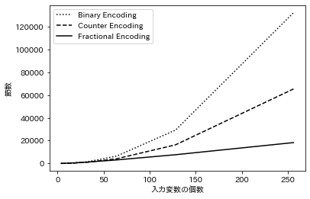
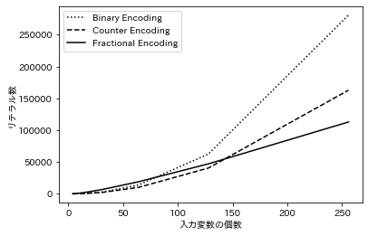
experiment
Comparison with existing methods
70
128
clauses
number of literals
number of input variables
number of input variables
128
Notes:
We compared the number of clauses with existing methods.
The left graph shows the number of clauses on the vertical axis and the number of input variables on the horizontal axis. The number of clauses is successfully reduced from the other methods when the number of input variables exceeds 70.
The right graph shows the number of literals on the vertical axis. The number of literals can be reduced from the existing method when the number of input variables exceeds 128.
From this result , it can be said that Fractional Encoding was able to suppress the scale of logical expressions

Slide 23
summary
Fractional Encoding can greatly reduce the scale of logical expressions compared to existing methods
Currently, only At-Most-K constraints with specific patterns can be created, so generalization considering exhaustive patterns is necessary.
If it can be generalized, it is an effective method for various real problems.
Notes:
Finally, here is a summary.

